Slide 1
CMSC 471
Project Group 16
Connect Four
Group Members:
Candace Campbell, Cassidy Crouse, Chidi Ede, Mathew Ferry

Slide 2
Project Option 3:
“Formulate, implement, and compare a novel solution to an existing problem”
Chose to make a Connect Four AI that uses a minimax algorithm
Connect Four is strongly solved [Numberphile]
Calculating the perfect solution is hardware intensive
Complicated, math heavy, nebulous solutions for which academic research papers have been written
Instead, create a Connect Four AI that uses a heuristic to mimic human play
Goal: Easier to understand, more explainable decision making process
Goal: Still able to look ahead several turns
Goal: Make decisions quickly

Slide 3
Connect Four
Tic-Tac-Toe like game played on a six row by seven column board
As game persists, players take turns placing their piece in a column
If a column fills it can no longer be played
If a player lines up four consecutive pieces, they win
If the board fills, the game results in a draw

Slide 4
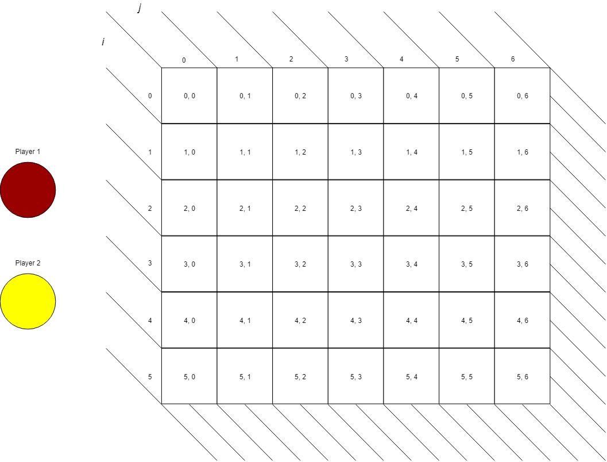

Slide 5
Zero-sum Game
Non-cooperative sequential zero-sum game of complete knowledge
There could exist a strategy or set of mixed strategies that leads to an optimal solution [Citation Needed]
John Tromp worked on developing a method to perfectly solve Connect Four in 1995
Connect Four of a regulation board is strongly solved
Can tell if a given game board will lead to a win, a loss, or a draw
If our game board is fresh, the first player can potentially win every time
Introduces the concept of a perfect game, played for 42 turns and ends on the last move

Slide 6
Search Space
There are 4,531,985,219,092 possible game states in Connect Four [Numberphile]
A general perfect solver would generate and evaluate all of these nodes
In actuality, they eliminate search space that is entirely unlikely to occur
Our solver(s) are only concerned going as deep into search space as hardware will allow

Slide 7
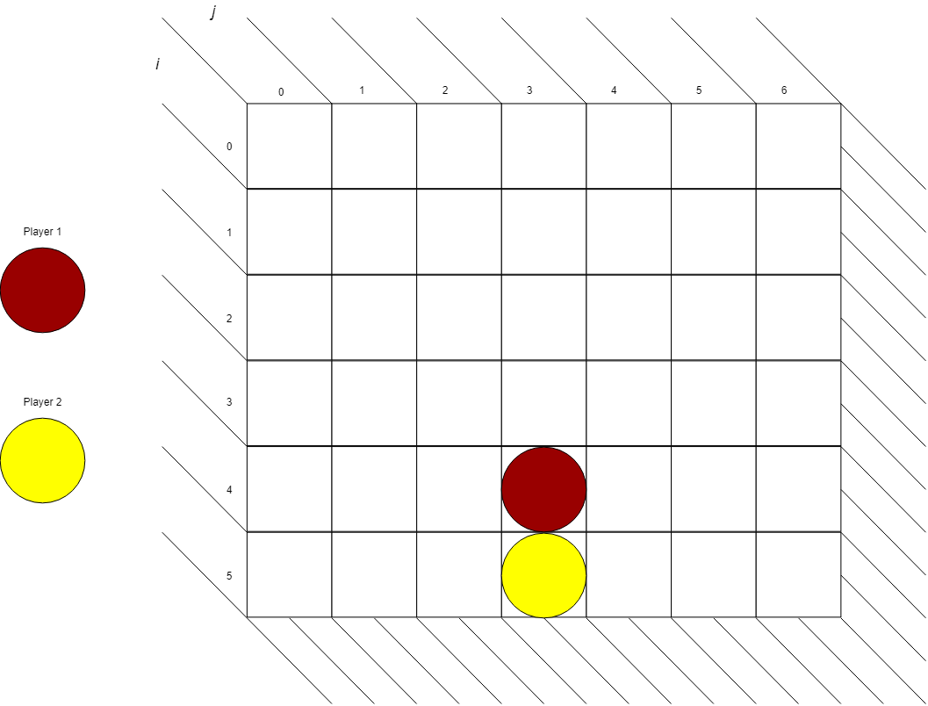
Notes:
Invalid because player 2 went first

Slide 8
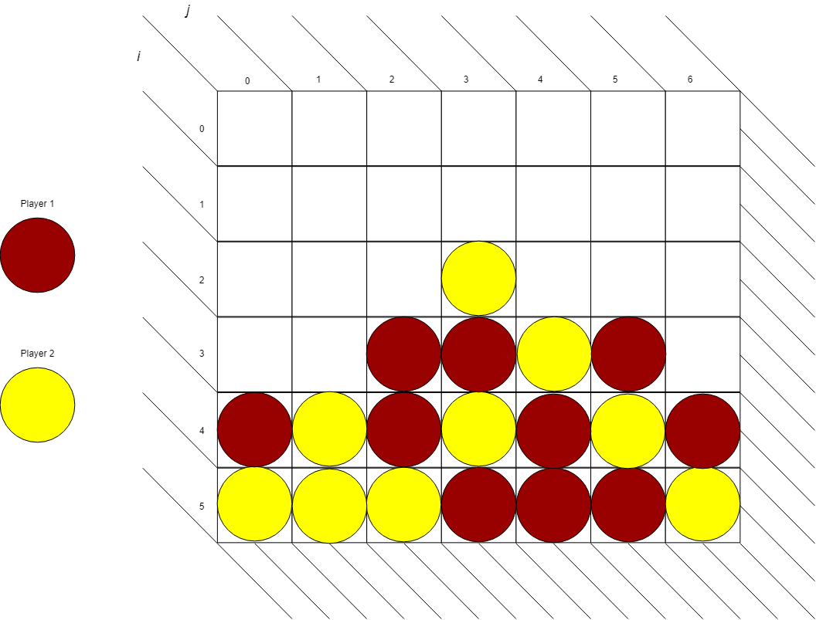
Notes:
Invalid because red must have played a piece even after yellow had already one

Slide 9
Minimax
Proposed minimax algorithm may use a multi-way tree to descend down to the terminal states
Each node is a different game state
Contains the board
Contains the move that got it there
Evaluation of the board
A strong Connect Four solver would explore all possible game states
We only explore as many as we can without having to change hardware or our minimax implementation

Slide 10
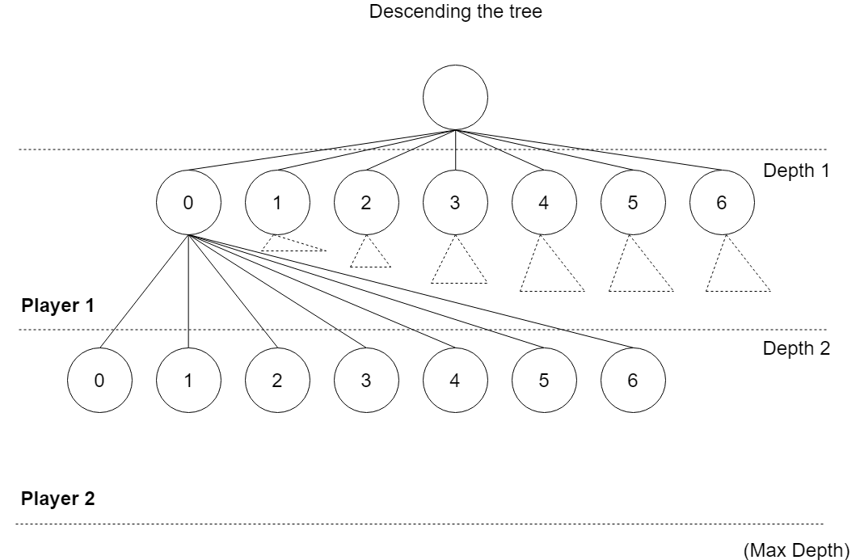

Slide 11
Easy AI
Still uses minimax to look ahead
Unless victory is assured in at least as many turns we look ahead, perform a random action
Not a strong solver
Cannot play as well as a human
Tests our conceptual understanding of minimax and sets foundation for better AI

Slide 12
Evaluating a Game Board
Keep track of the last player’s move at every step
Have we found a win yet?
Count other attributes of the board (explained later)
Number of disjoint sets of a single piece
Number of disjoint sets of two pieces
Number of disjoint sets of three pieces
Number of “fatal columns”

Slide 13
Finding a win
Finding a win without knowing the last turn would take at least o(n²) as we need to check the entire board
Instead of checking the entire board, pass our checkWin() function the last move that was played
This then checks in all directions for a win

Slide 14
Checking a win
Vertical,Horizontal,LDiagonal,RDiagonal = 0
For i = 0 to 6
Check stripes of seven along the horizontal
If the stripe contains the players piece
Horizontal++
Else
Horizontal = 0
Check stripes of seven along the vertical
… // same as above
Check stripes of seven along both diagonals
… // same as above
If any of the counters are 4
Return 0
Else
Return -1
Board is given
Player is given
Row is given
Column is given
Uses row and column as an “intercept”

Slide 15
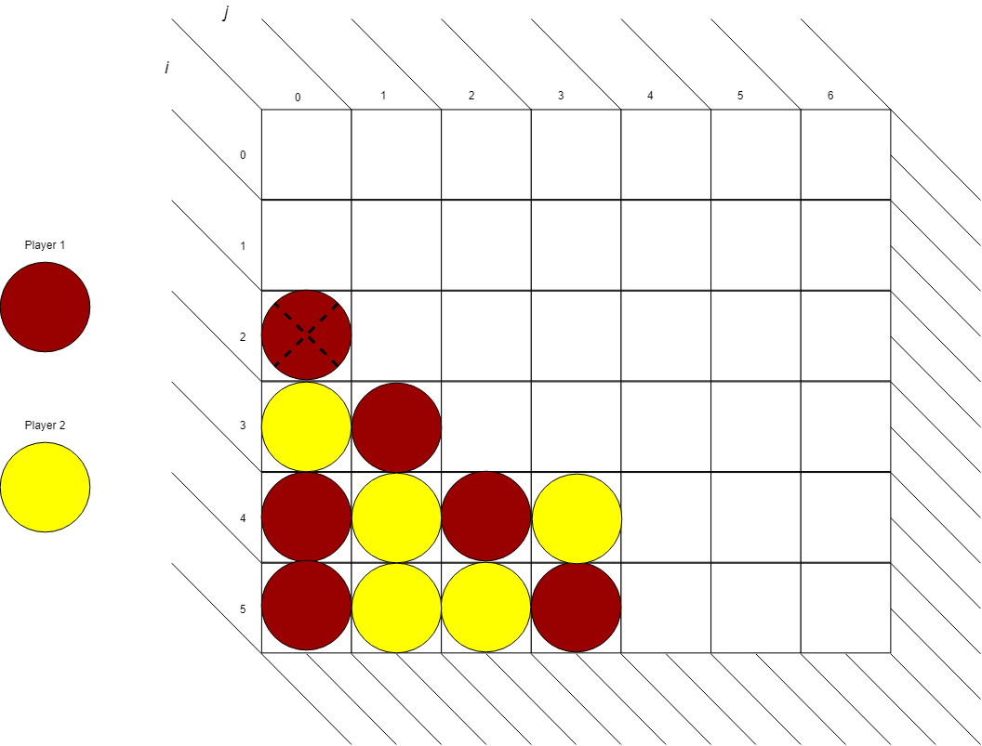

Slide 16


Slide 17
Easy AI Conclusion
Using checkWin() we evaluate all of the terminal states at the bottom of the gamespace tree
Keeping in mind that the players alternate, if we are guaranteed a win (given that the opposing player plays optimally) move towards it
If all the weights are equal (and they often are) perform a random action

Slide 18
Utility-based AI
Proposed implementation should remove the need for making random decisions
Seldom will two column choices have the same score
Proposed implementation should play better than making random decisions using a different strategy
Utility function with attributes and weights

Slide 19
Disjoint Sets
Disjoint (and joint) sets of moves represent potential four connections by a given player
For example the set [O, - , O, O] is a disjoint set of three connections for player ‘O’
Proposed to have different weights such that:
Ones < Twos < Threes

Slide 20
Disjoint Sets Cont.
Disjoint sets are found by examining each possible location on the entire board
Horizontally, there are 24 possible stripes of disjoint sets
Vertically, there are 21
In each diagonal, there are 12 for a total of 24.

Slide 21
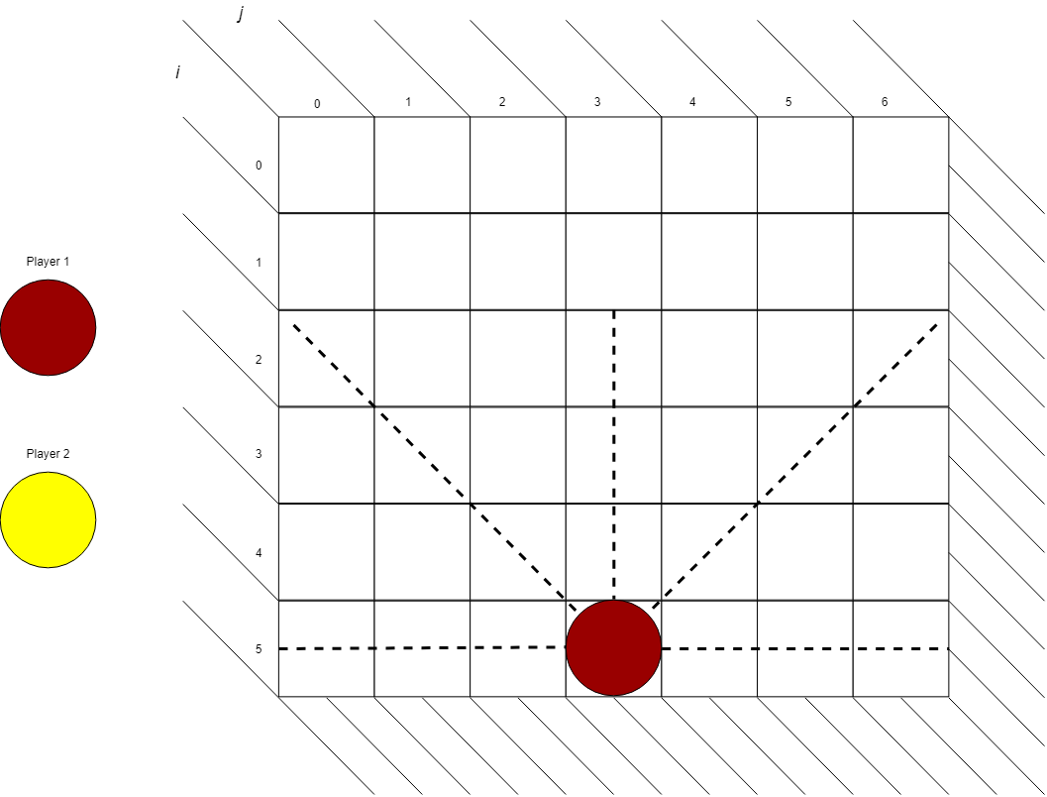

Slide 22
Finding Horizontal Disjoint Sets for a Player
Board is given
Player is given
Horizontal = 0
Ones = 0
Twos = 0
Threes = 0
For i = 0 to 6
For j = 0 to 7
If board[i][j] could be a disjoint set
Check all of the 4 sets contents
If the set contains only player pieces and blanks
Horizontal = number_player_pieces
Else
Horizontal = 0
Switch Horizontal
Case 1:
Ones++
Case 2:
Twos++
Case 3:
Threes++

Slide 23
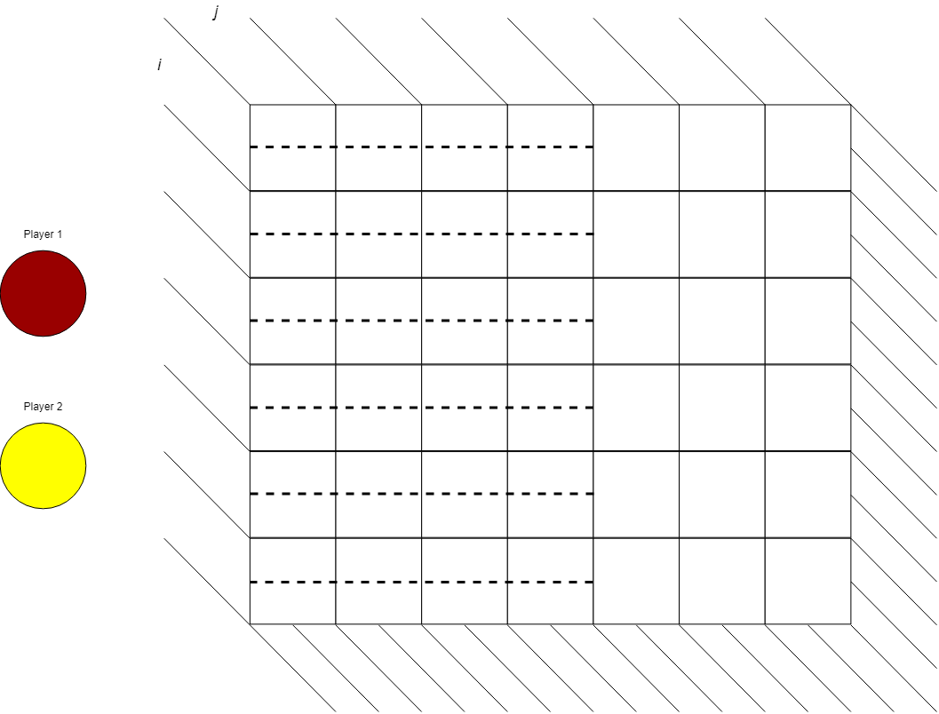

Slide 24
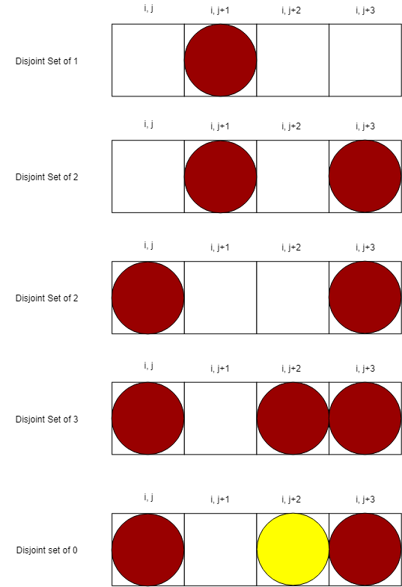

Slide 25
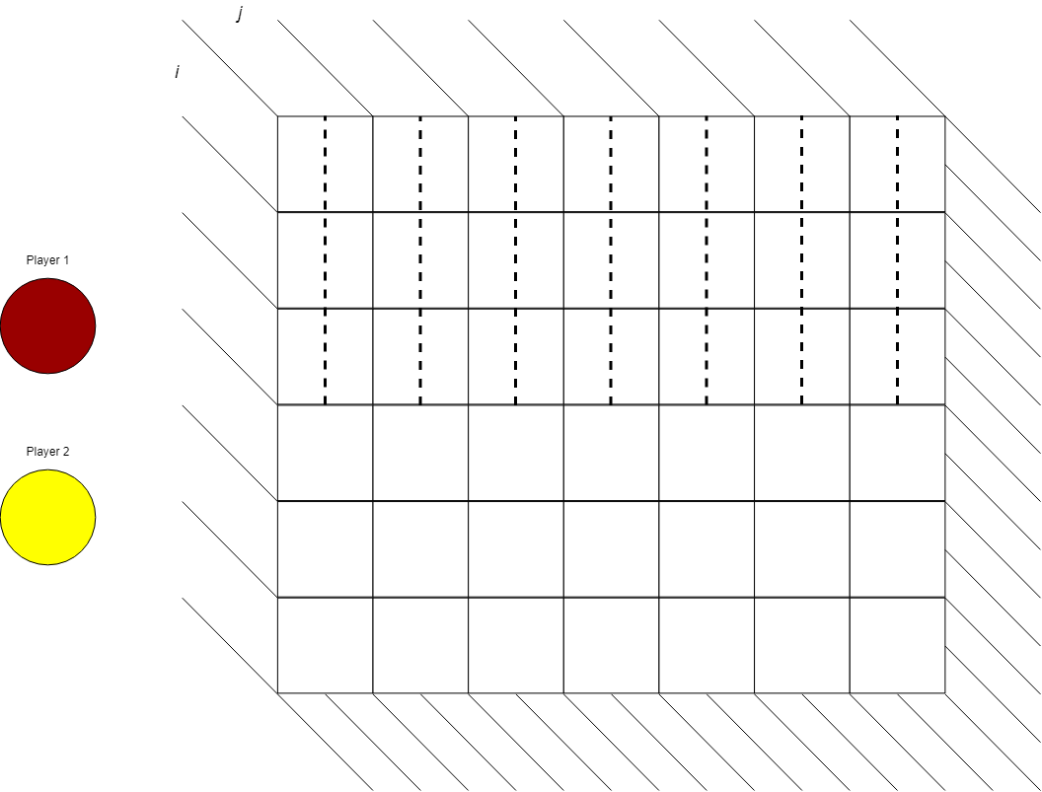

Slide 26
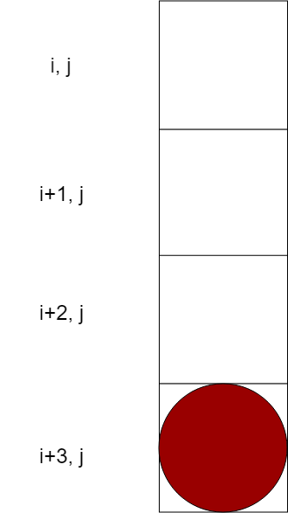

Slide 28
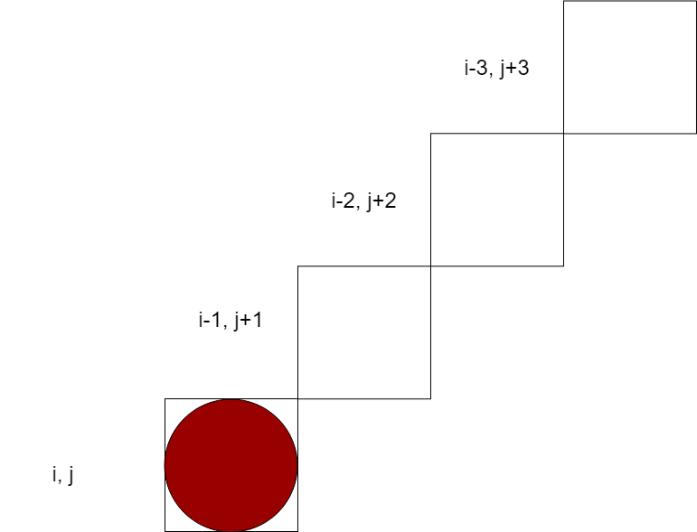

Slide 29
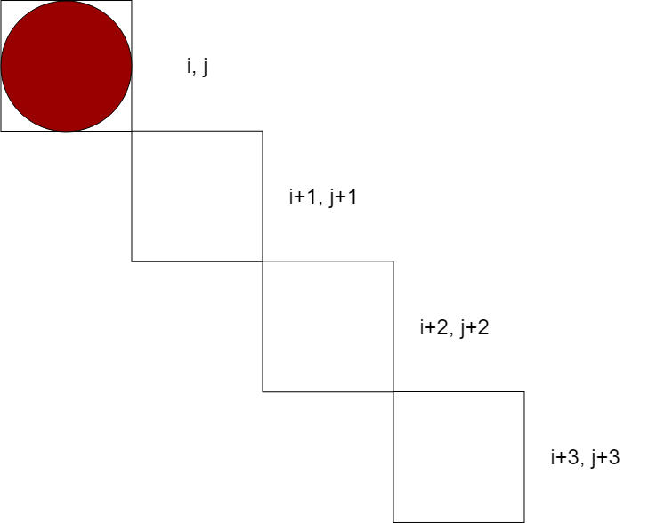

Slide 30
“Fatal” Columns
A column that, if played by the opposing player, the current player can play that same column and win
Very high weight, proposed to be more than all of the disjoint sets combined
Proposed to be valuable as an attribute because they are not useful right away
May take as many as a dozen turns before they become a factor
Effectively removes a column of play restricting oppositions options

Slide 31
“Fatal” Columns Cont.
Simply check if a column is a win by copying the board and testing if a hypothetical win is possible if it is played twice.
Do this for all columns to count the total.
A fatal column is said to be controlled by one player if the other player loses by playing it
It is a good for player 1 if he controls a fatal column
It is bad for player 1 if player 2 controls a fatal column

Slide 32
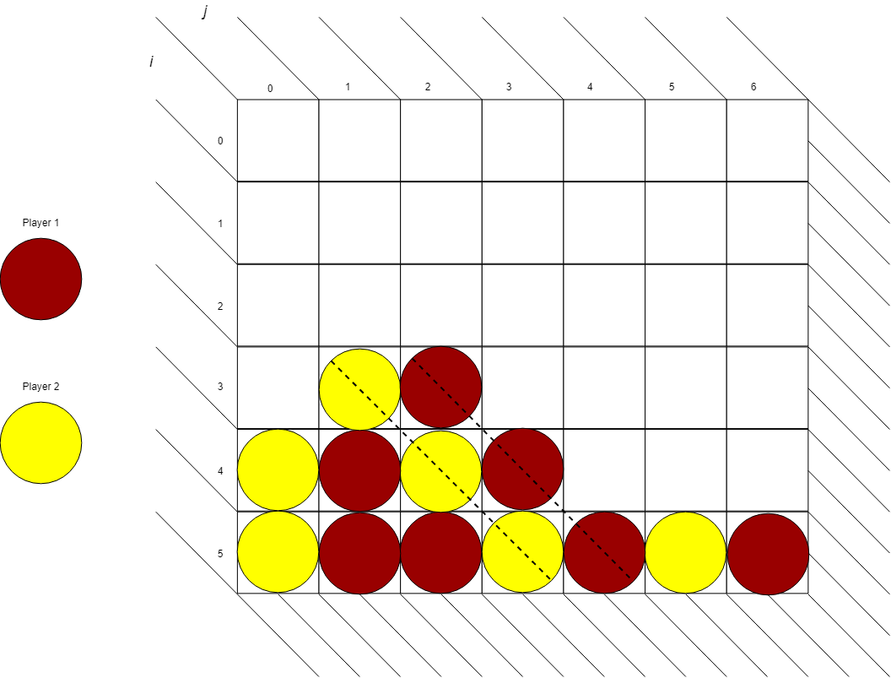

Slide 33
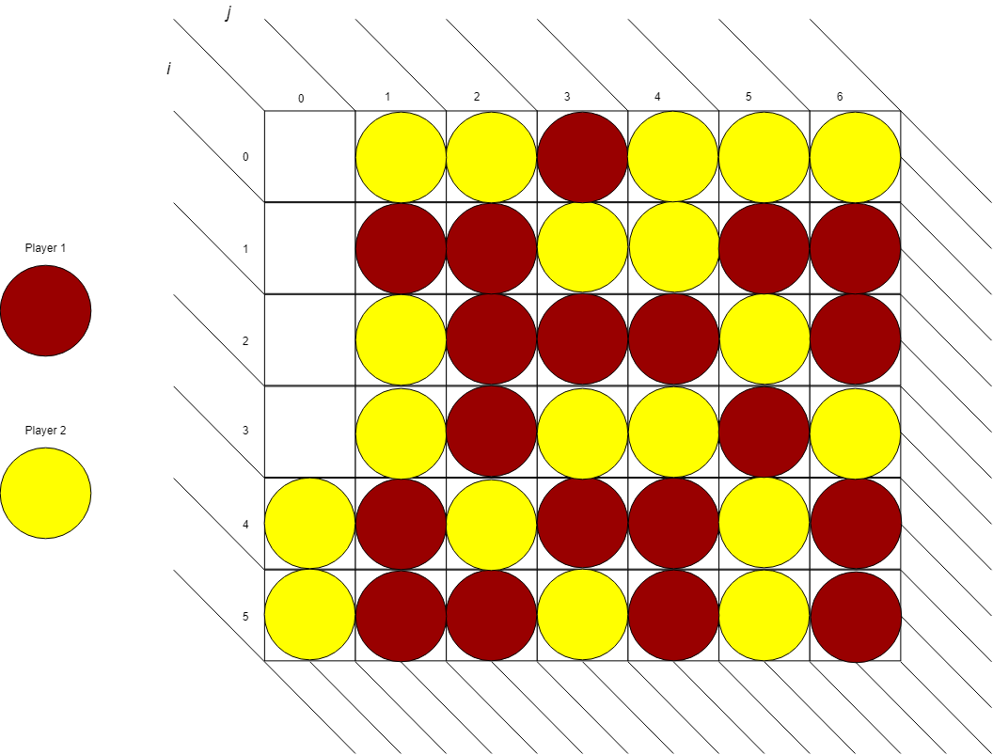

Slide 34
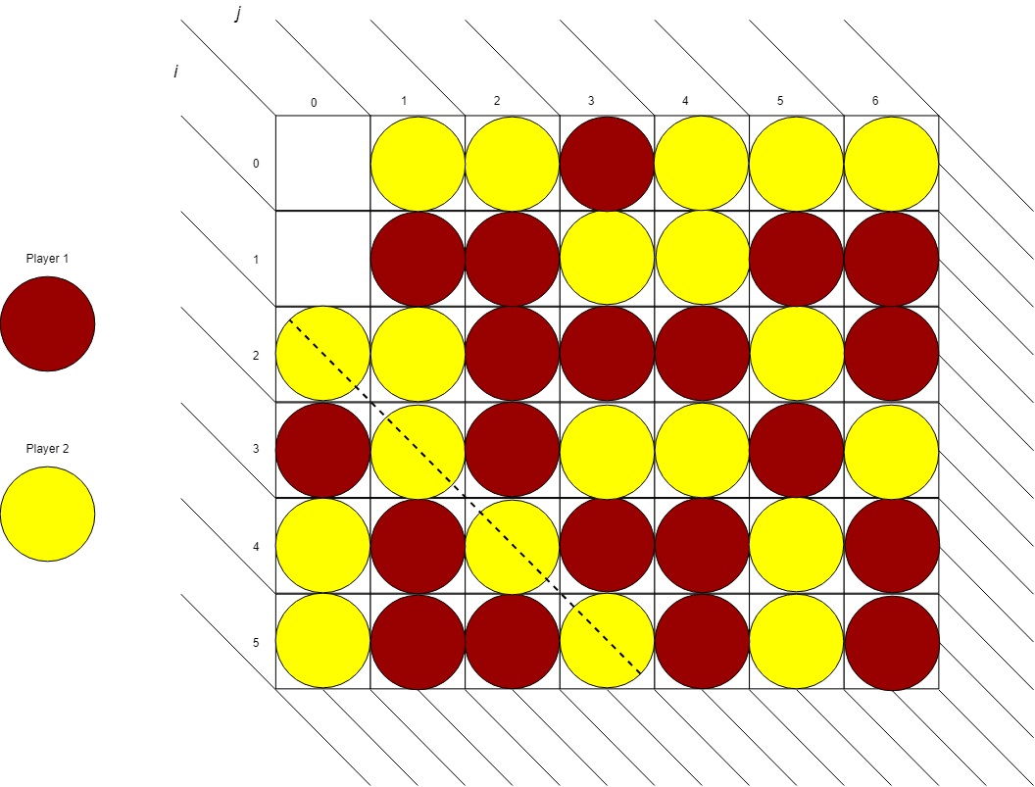

Slide 35
Utility Function Concept
Use the proposed set of attributes of a game board
Apply weights to each attribute
Evaluate the score for the player who controls the attributes based upon these weights
Score(board, player) = player.num_ones * w_{ones} + player.num_twos * w_{twos} + player.num_threes * w_{threes} + player.num_fatal * w_{fatal}

Slide 36
Utility Based AI Conclusion
Set of weights is not finely tuned, have simple values
wOne = 1
wTwo = 10
wThree = 100
wFatal = 1000
Our implementation does not play as well as we would have hoped
Very complex, nearly 800 lines of code
Logical errors in code
Definitely less random, but favors left columns (recursion goes from left to right)
Not as explainable as we hoped

Slide 37
Easy AI Statistics
Due to the nature of Easy AI, a more or less unique game is played every time
Simply initialize two AI and have them play each other
Do this many, many times
Find win distribution
Find mean time per turn
Expected:
Win percentages should more or less random
Increasing the maximum depth will increase time per game and time per turn

Slide 38
Lookahead Depth of 5:
10000 games played
Player 1: .3263
Player 2: .6007
Draw: . 073
Total run time: 8:53
Average time per turn: 1.287 ms
Time per game: .053 s
Lookahead Depth of 7:
1000 games played
Player 1: .287
Player 2: .629
Draw: .084
Total run time: 39:22
Average time per turn: 78.051 ms
Time per game: 2.363 s
(Data collection built in to the Easy AI, plays random moves when it encounters equal weights so feeding in data won’t be very useful)

Slide 39
Utility-based AI Statistics
Due to the nature of the Utility-based AI, two AI opponents will play exactly the same game every time starting from a fresh board.
No random moves, best move first (favors left recursion on equal weights because that’s the first move it sees)
Generate valid game boards of a sufficient depth that it is unlikely for the AI to play the exact same game every time
(between 5 - 15 turns as there are thousands if not hundreds of thousands of unique permutations at that point)
Find same statistics
Additionally the number of game permutations explored (and thus scores calculated)
Same expectations as before

Slide 40
Lookahead Depth of 5:
1000 games played
Player 1: .632
Player 2: .317
Draw: .051
Total run time: 6:56
Average search size per turn: 4587.38
Average time per turn: 18.039 ms
Time per game: .416 s
Lookahead Depth of 7:
100 games played
Player 1: .63
Player 2: .28
Draw: .09
Total run time: 21:05
Average search size per turn: 155534.44
Average time per turn: 580.54 ms
Time per game: 12.65 s
(Data collection built in to the Utility-based AI, it generates random boards and then has 2 AI play each other)

Slide 41
Conclusion
Should not have reinvented the wheel and attempted recursion without multiway tree
Took longer to devise and implement
Found to be more difficult to debug
May not be entirely functional, hard to tell as it is unexplainable at deep depths due to the size of the search space
Should have allowed more time to fine tune the weights of our attributes
Did not yet devise a method of optimizing them
Other factors not considered
Height of a disjoint set (higher the set on the board, less likely it is to be useful)
Both AIs fall prey to simple strategies and maneuvers that are analogous to a fool’s mate in Chess

Slide 42
References (In Final Report as well)
Numberphile - www.youtube.com/watch?v=yDWPi1pZ0Po (referenced better in the final report)

